Slide 1

NSG Pilkington – University of Liverpool Machine Learning Project: 11/08/2021
Dr. Peter Green
Engineering Data Analytics Ltd
School of Engineering, University of Liverpool

Slide 2
Last Week
From previous meeting:
Implementation of PoE Gaussian Process model:
Using all of dataset 3 as training.
Using concatenation of datasets 1, 2, and 3 as training.
PCA only showing key inputs identified by the GP.
Including confidence bounds.
Updating input names
Apply to MK4 and ISRA
Next steps:
Updating input names
Process ISRA data
Linear regression only videos
MK4
ISRA
Generalised PoE GP only videos
MK4
ISRA

Slide 3
Today
Updating input names
Product-of-Experts Gaussian Process results
MK4
ISRA
Comparing MK4 and ISRA training data
Which inputs are important?
Generalised Product-of-Experts Gaussian Process
Conclusions

Slide 4
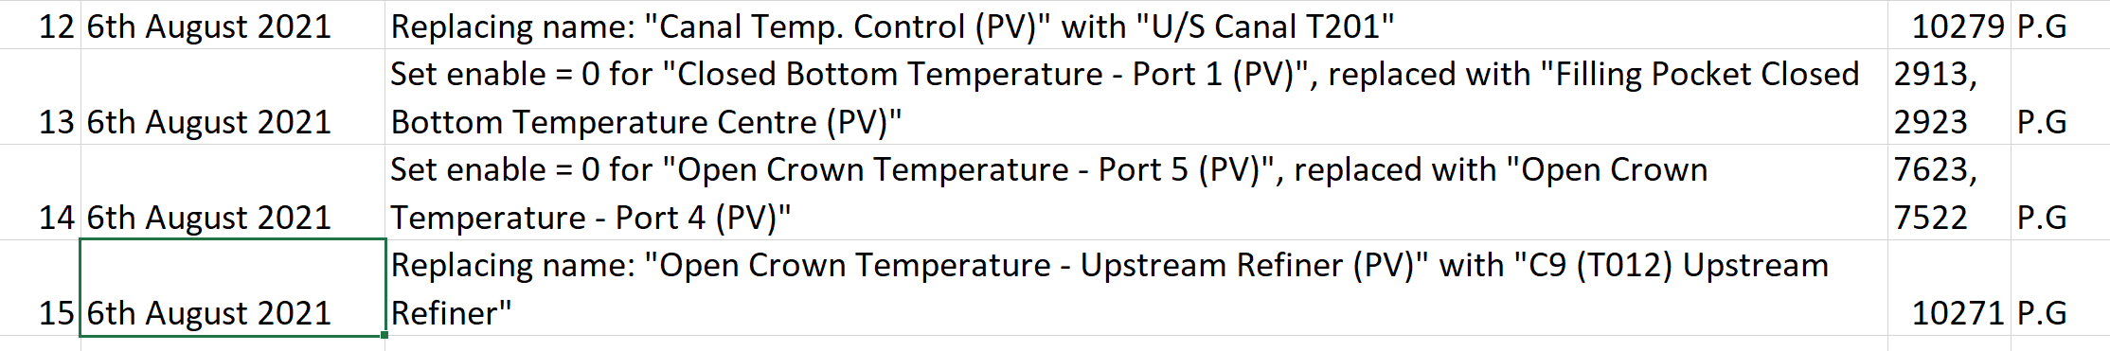
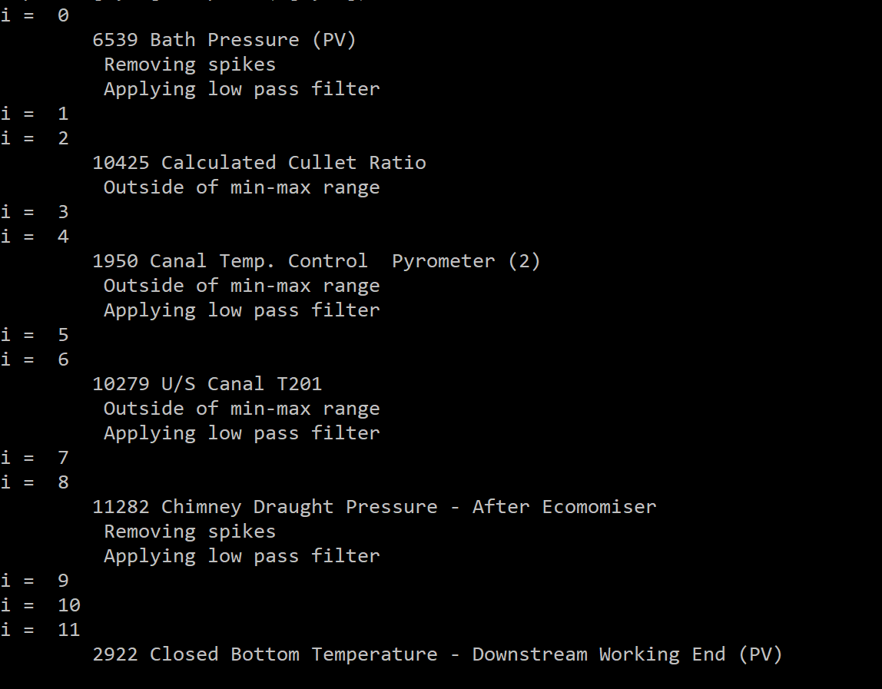
Updating Input Names
Inputs changed to match those used in the control room (and noted in ‘Input Pre-processing’ spreadsheet).
The pre-processing applied to each signal can now be printed – may be useful when the model is deployed on Sequoia.

Slide 5
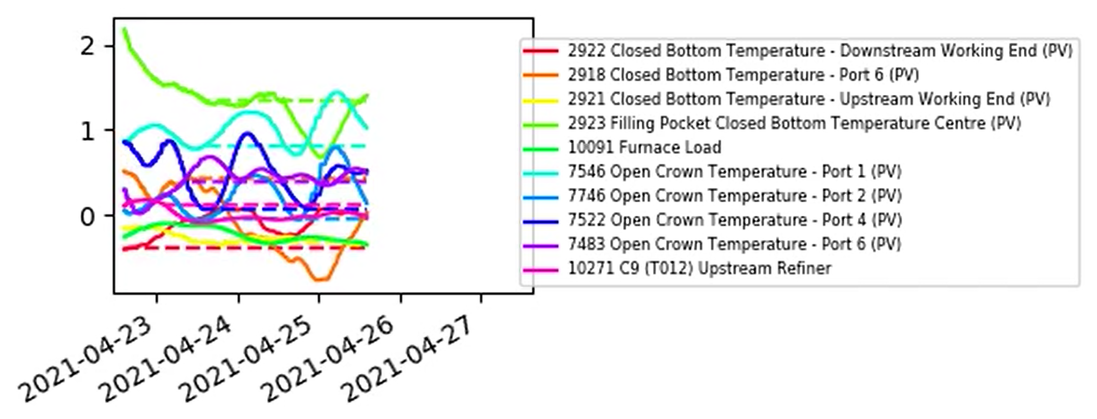
Updating Input Names
The inputs used in the following results:

Slide 6
Product-of-Experts Gaussian Process Results
The Product-of-Experts Gaussian Process (PoE-GP) approach allowed us to:
Scale the GP model to larger datasets
Bring in ‘experts’ that cover important events
Last week we were still observing the ‘flatlining’ behaviour, despite previous success of the GP model using a subset of the training data we are now employing.
It was suggested that this could be overcome using a ‘Generalised’ PoE-GP (more on this later).
Further investigations revealed that:
The parameters of the PoE-GP are found using a ‘hill climbing’ approach, but were often getting stuck in local maxima. Resolved by randomising the initial parameter estimates.
Not one GP with the same hyperparameters can accurately represent all of the different furnace states i.e. the sensitivity of the model to different inputs depends on the furnace state.

Slide 7
Product-of-Experts Gaussian Process Results
In the following:
The Independent PoE-GP model (where each ‘expert’ is allowed different hyperparameters).
Randomised initialisation of the parameter search for each model.
Trains on the dataset (15,000 points) in less than 10 minutes.
Each prediction takes around 1 second – fine for us so long as it’s less than 20 minutes!
Python is slow so lots of scope for speed-up if we need it.
Time-varying Linear Regression, with a fast learning rate, is included as an experiment.
ANN results removed for now.
PoE GP plots now include confidence bounds
Note: the literature reports some cases where the confidence bounds are “overly optimistic”.
This is dependent on the problem at hand and the no. of experts used.
Here we include the confidence bounds anyway, so that we can judge their suitability.

Slide 8

Product-of-Experts Gaussian Process Results (MK4)
The usual ‘flatlining’ behaviour that we see when the model is applied far from the training data.

Slide 9
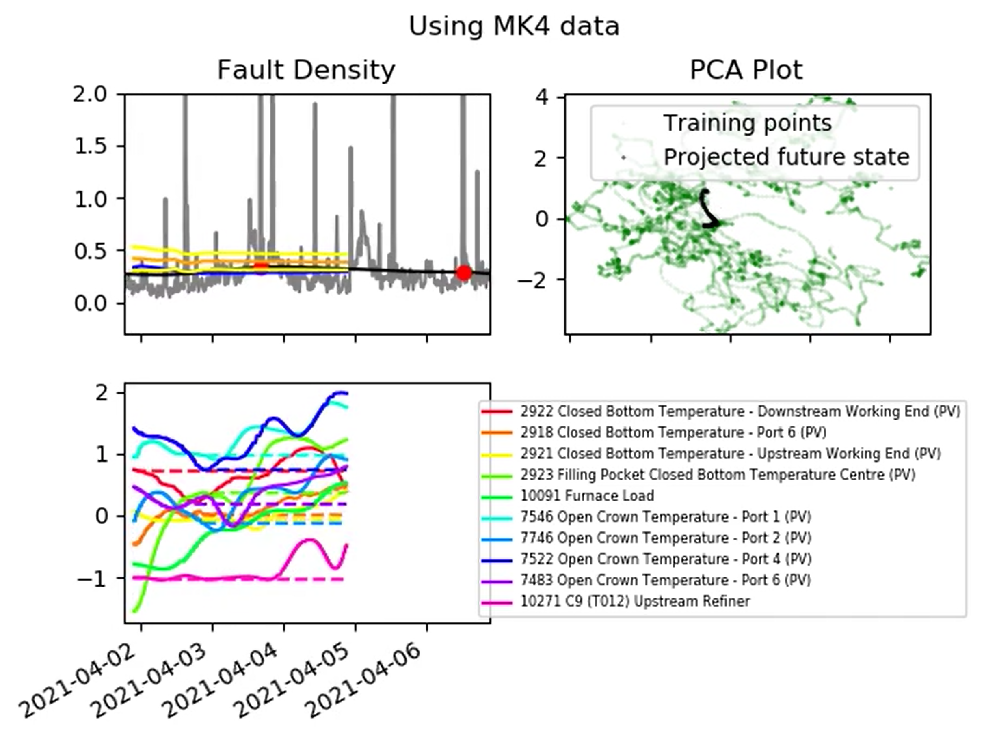
Product-of-Experts Gaussian Process Results (MK4)
Things look a lot better around April 2021.
This corresponds with the furnace state passing through some dense regions of the PCA plot.

Slide 10
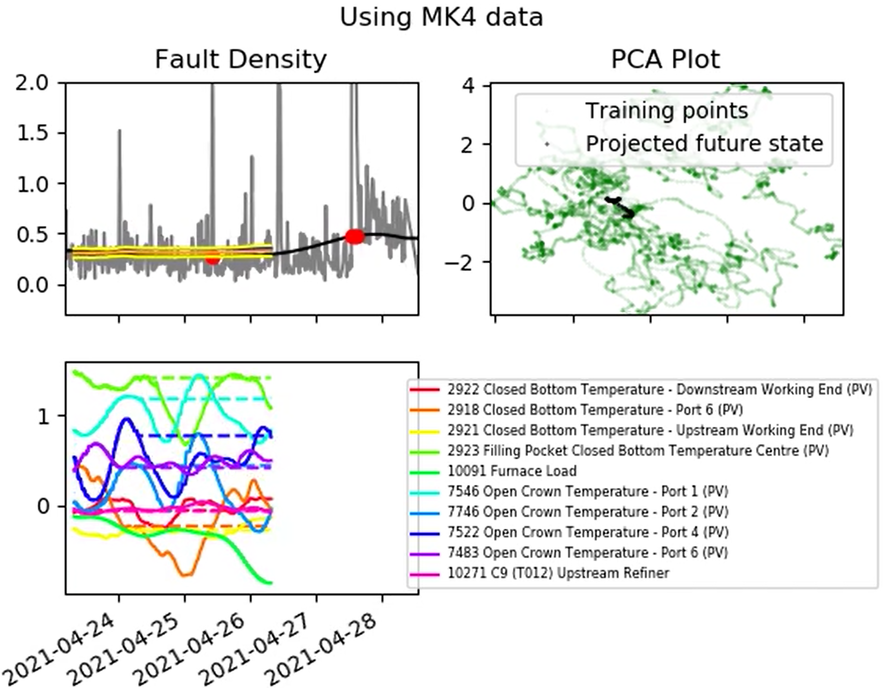
Product-of-Experts Gaussian Process Results (MK4)
Things look a lot better around April 2021.
This corresponds with the furnace state passing through some dense regions of the PCA plot.

Slide 11
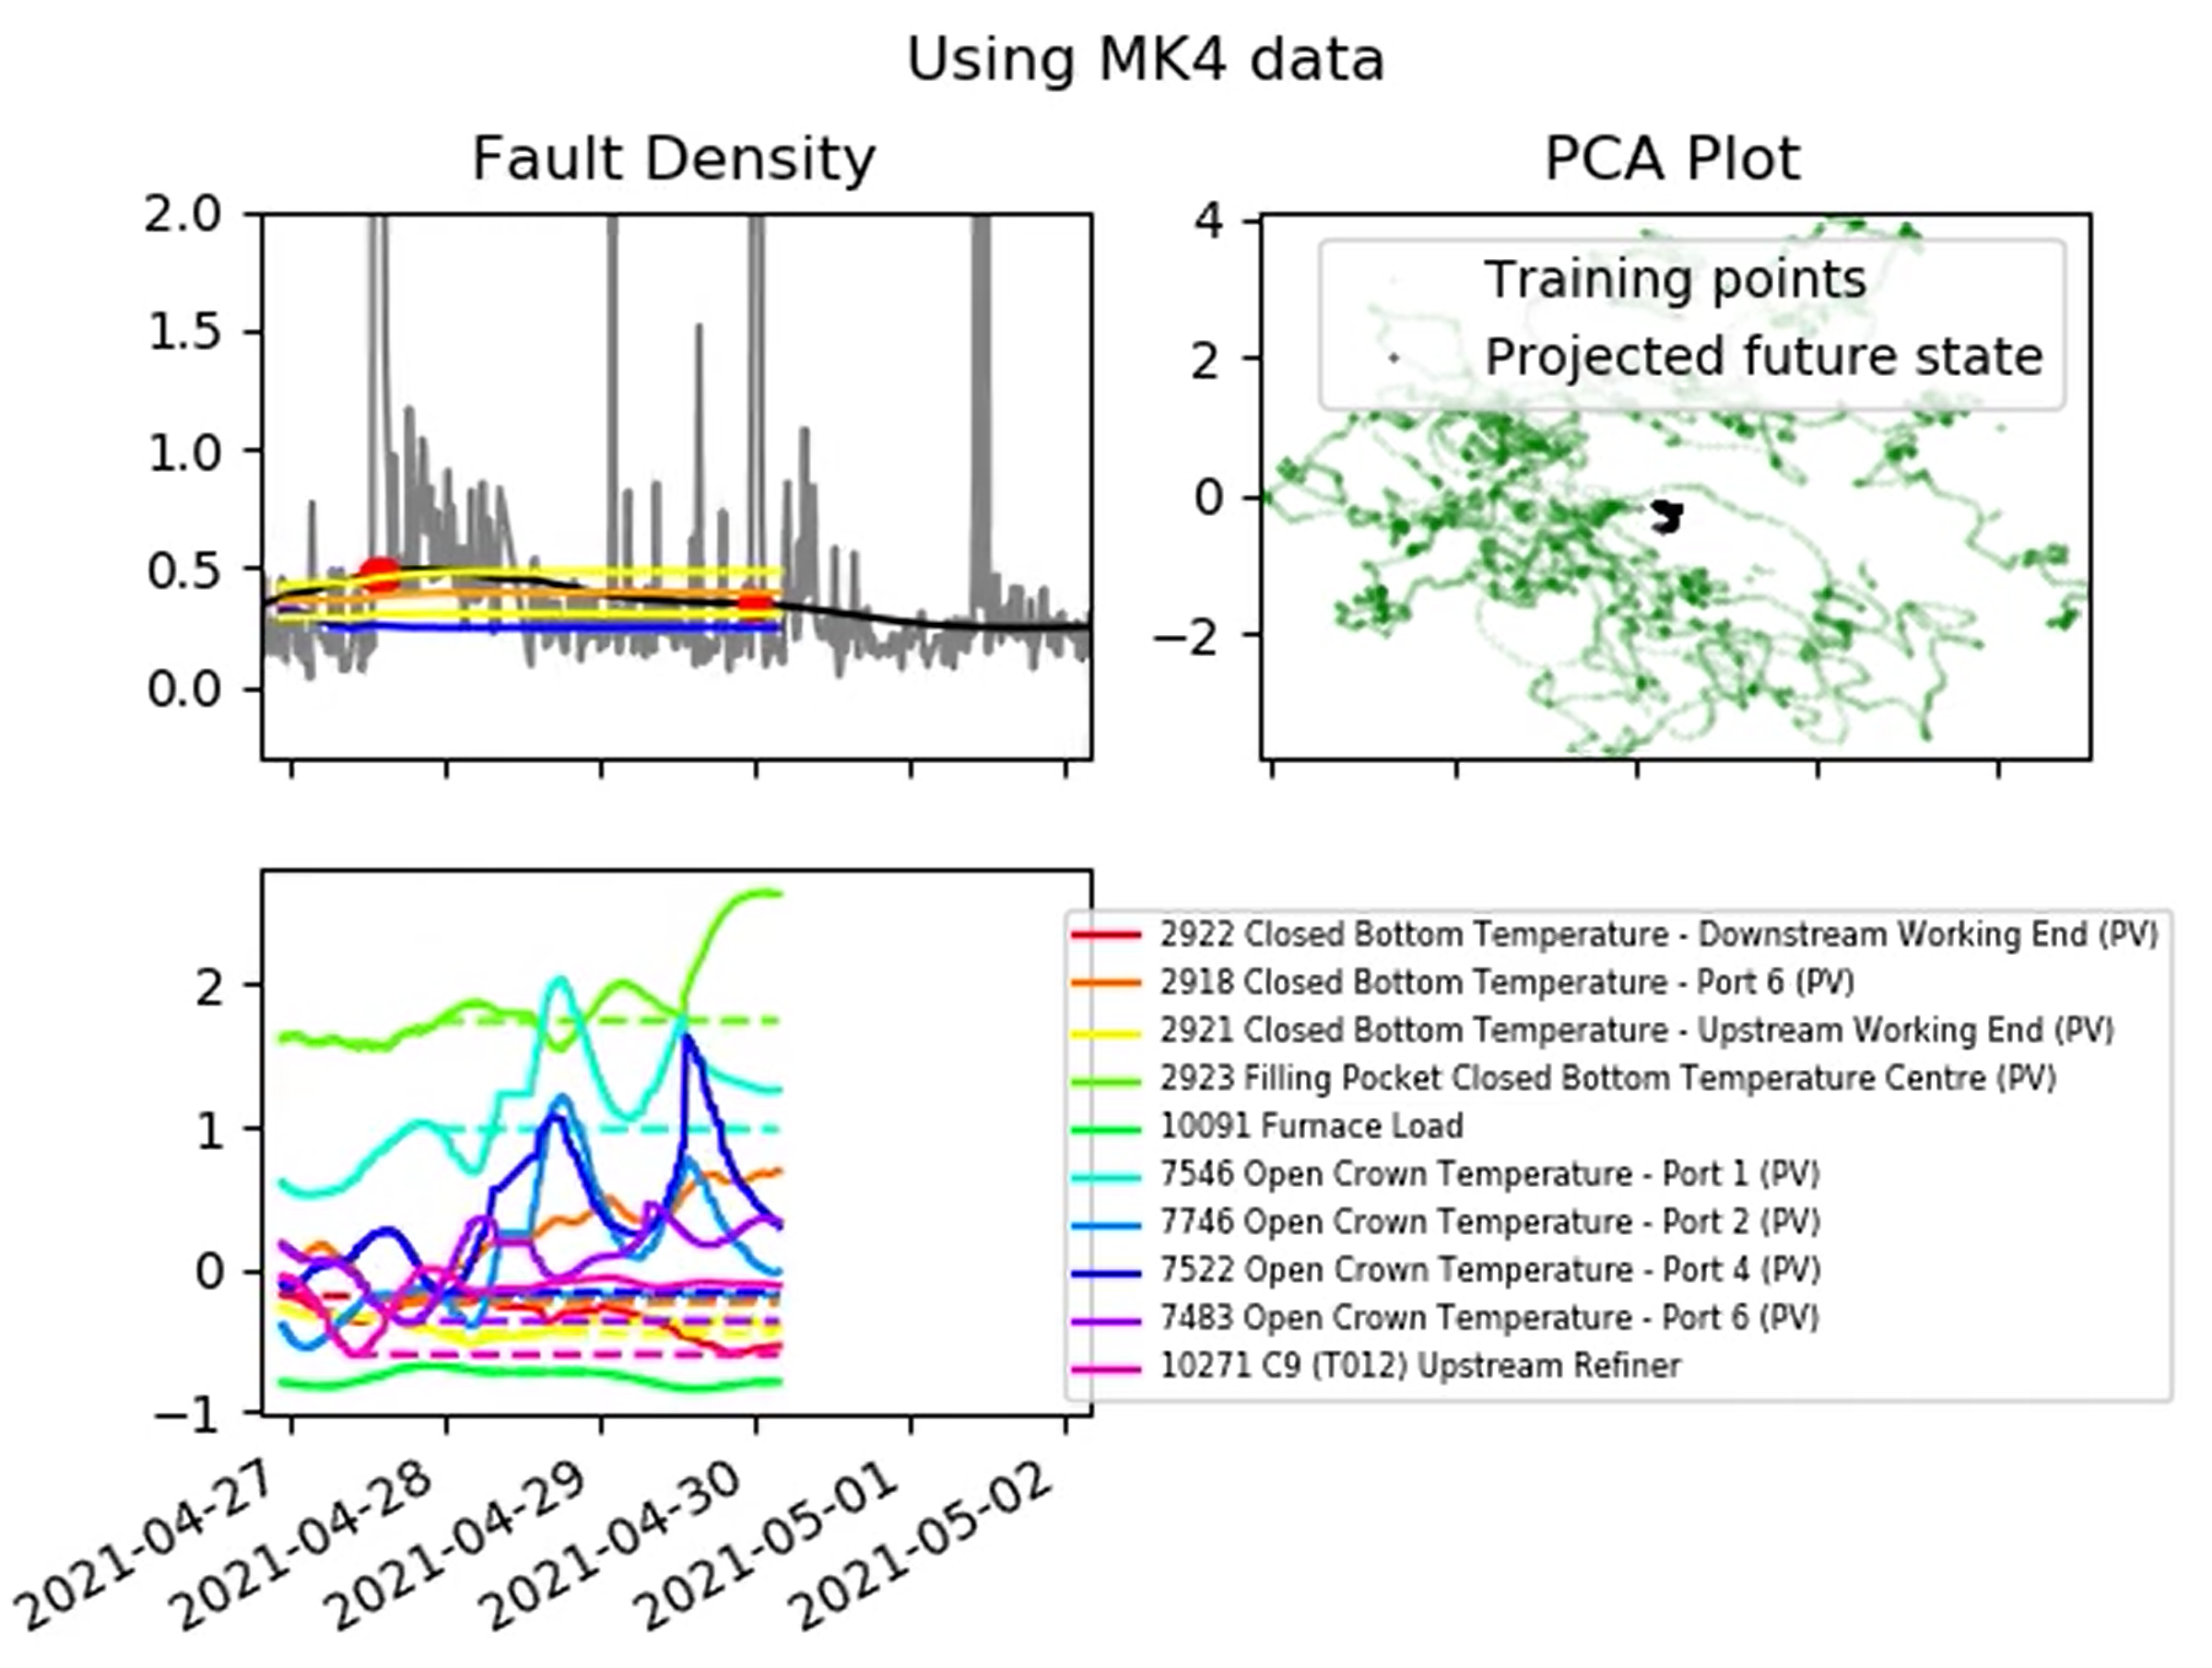
Product-of-Experts Gaussian Process Results (MK4)
Things look a lot better around April 2021.
The confidence bounds seem useful (here they expand to encompass a future rise in fault density).
The over-confidence brought about by the MoE-GP does not appear to be significant.

Slide 12
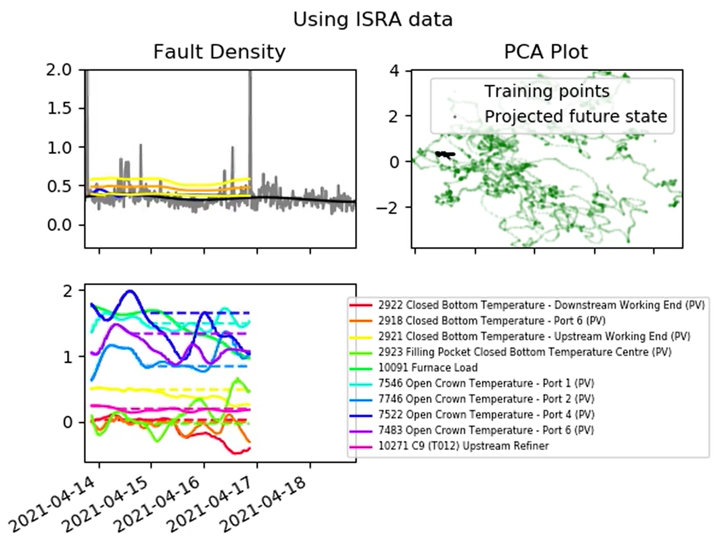
Product-of-Experts Gaussian Process Results (ISRA)
Now looking at the ISRA.
There are encouraging periods, but generally the results are not as good as when the MK4 data has been used.

Slide 13
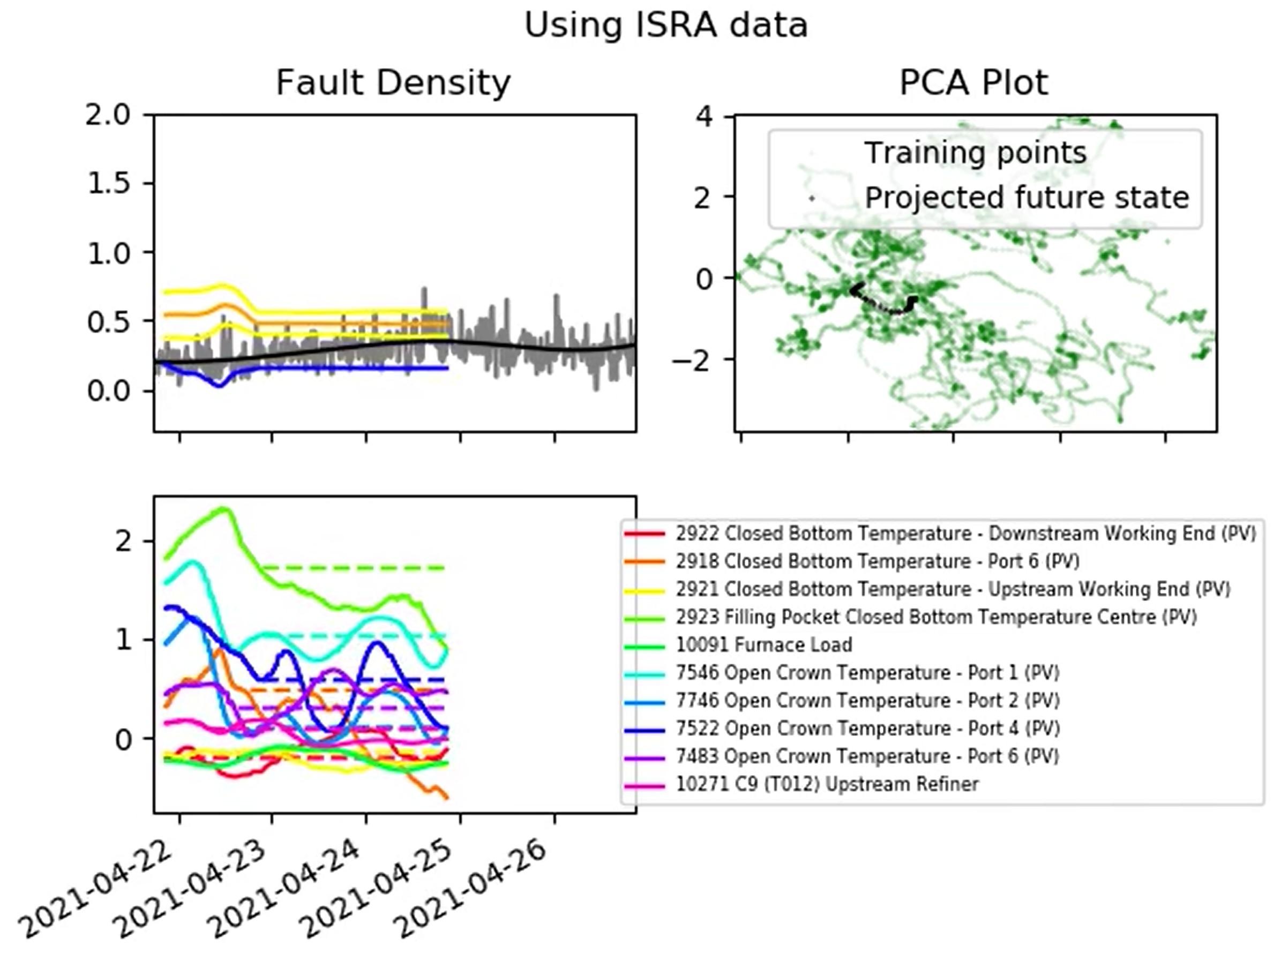
Product-of-Experts Gaussian Process Results (ISRA)
Now looking at the ISRA.
At this point the model deviates quite far from the ISRA signal.

Slide 14
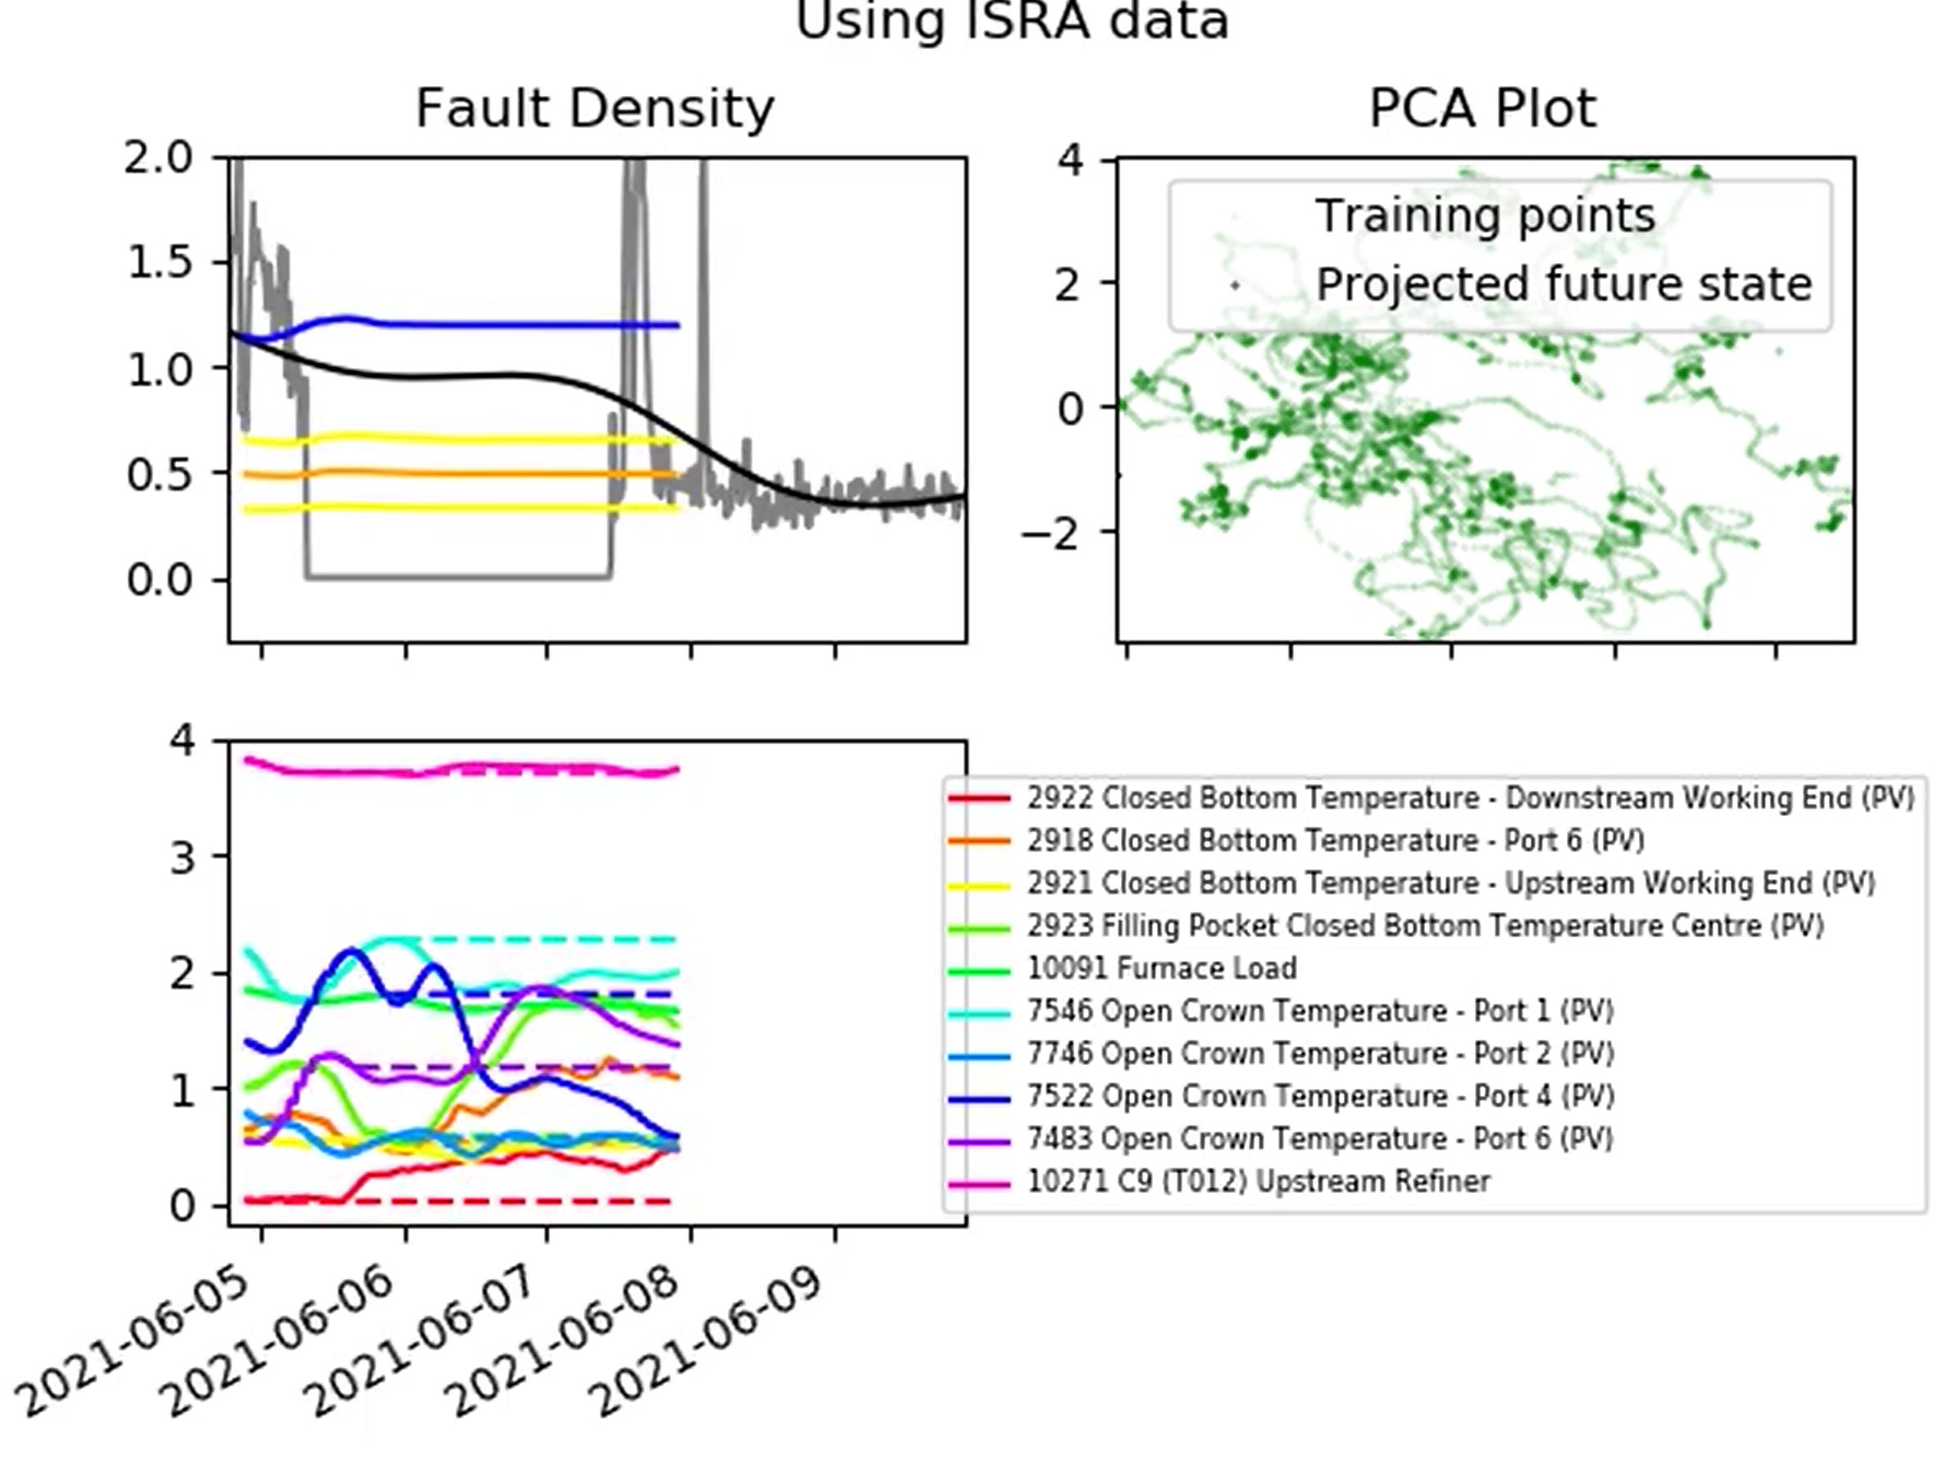
Product-of-Experts Gaussian Process Results (ISRA)
Now looking at the ISRA.
The ISRA signal still looks quite strange in some regions.

Slide 15
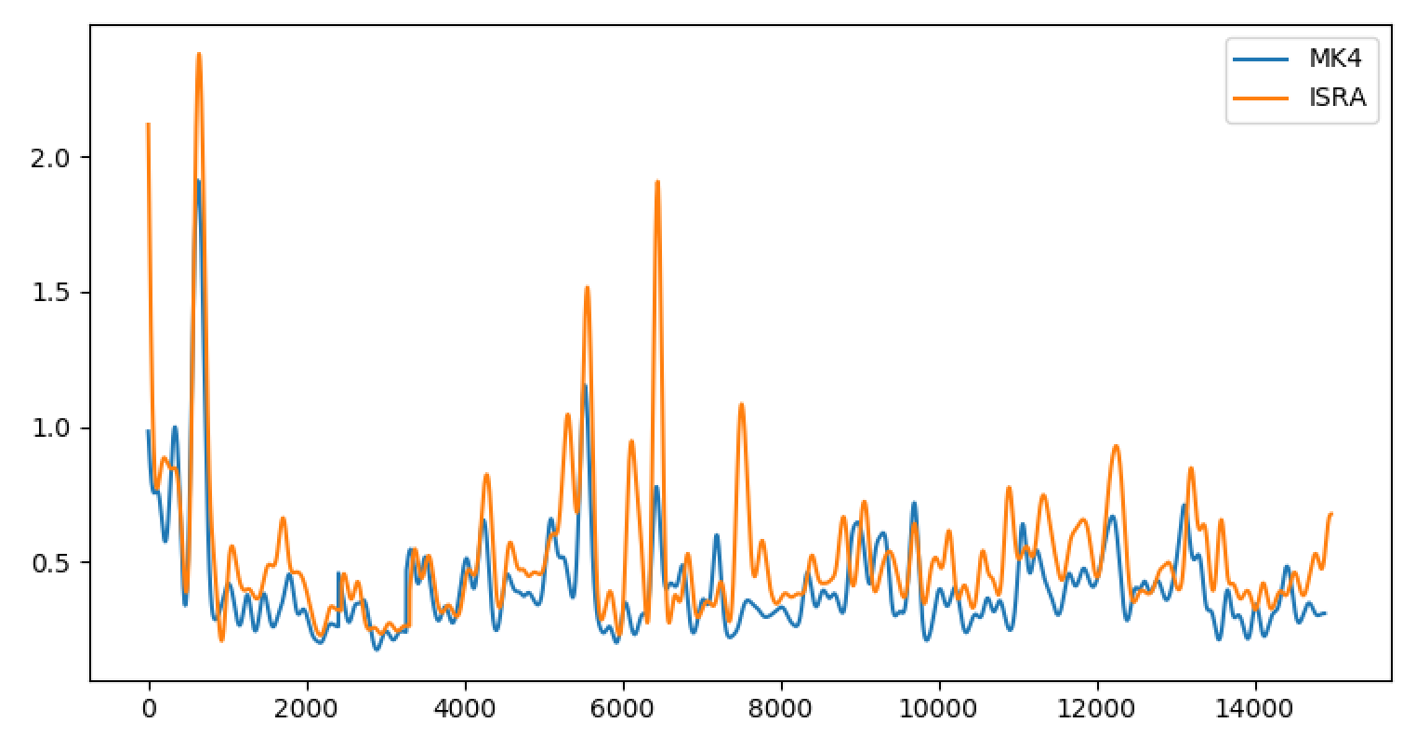
Comparing MK4 and ISRA Training Data
Clearly there are still some differences in the (post-processed) MK4 and ISRA data.
MK4 results seem to indicate that the modelling approach is suitable, so we may have to take another close look at how we process the ISRA data.

Slide 16
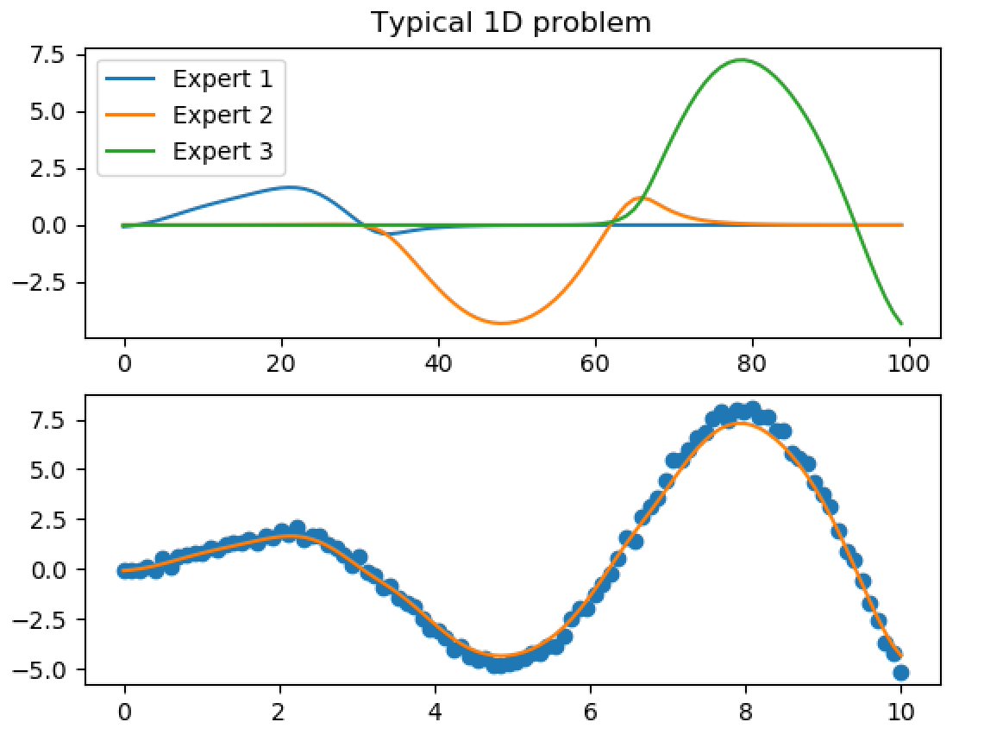
Which Inputs are Important?
This could get complicated, as each of our different “experts” will have their own list of important inputs.
Note that we don’t have a binary switch between the experts: the full predictions are a “blend” of the predictions made by each expert:

Slide 17
Which Inputs are Important?
Also note that, over the 72 hour prediction period, the expert with most influence could change!
The Generalised PoE-GP model offers a potential solution…
GP2
GP1

Slide 18
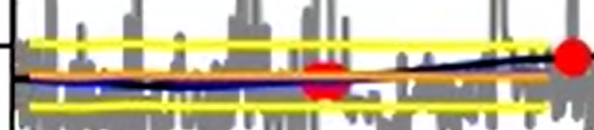

Generalised Product-of-Experts Gaussian Processes
Recap:
Each GP is multiplied by a “predictive power” factor before the product of GPs is calculated.
Predicted power essentially relates to the difference between:
The predictive variance of the untrained model (before it has seen any data i.e. the “flatlining”)
The predictive variance of the trained model
This should remove experts with low predictive power from having any influence on the predicted mean and standard deviation.
[2] Cao, Y., & Fleet, D. J. (2014). Generalized product of experts for automatic and principled fusion of Gaussian process predictions. arXiv preprint arXiv:1410.7827.

Slide 19
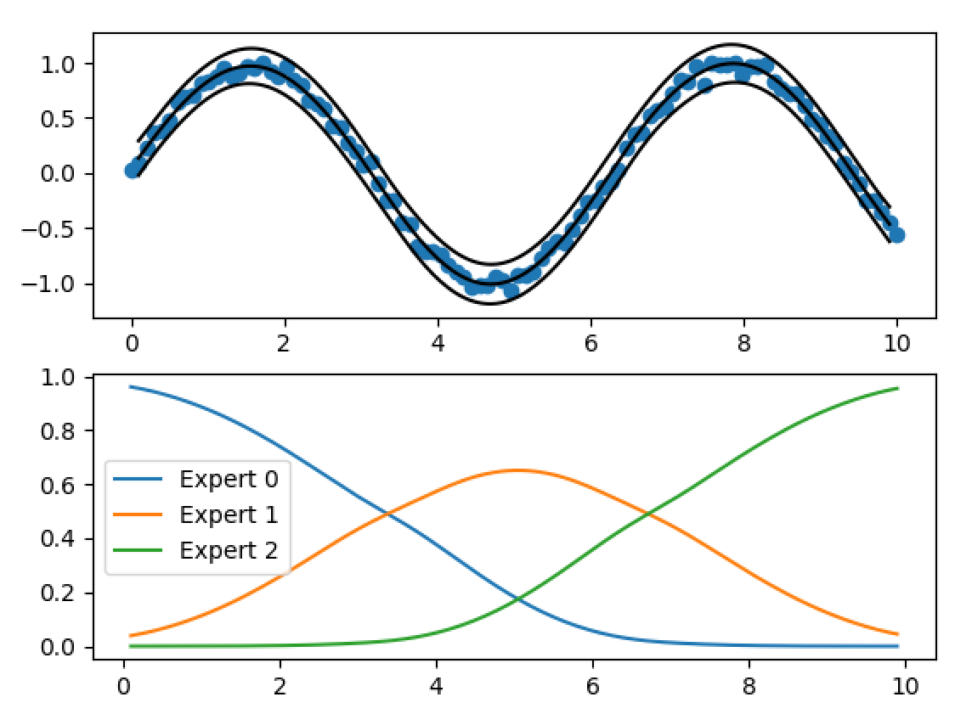
Generalised Product-of-Experts Gaussian Processes
Predictive power

Slide 20
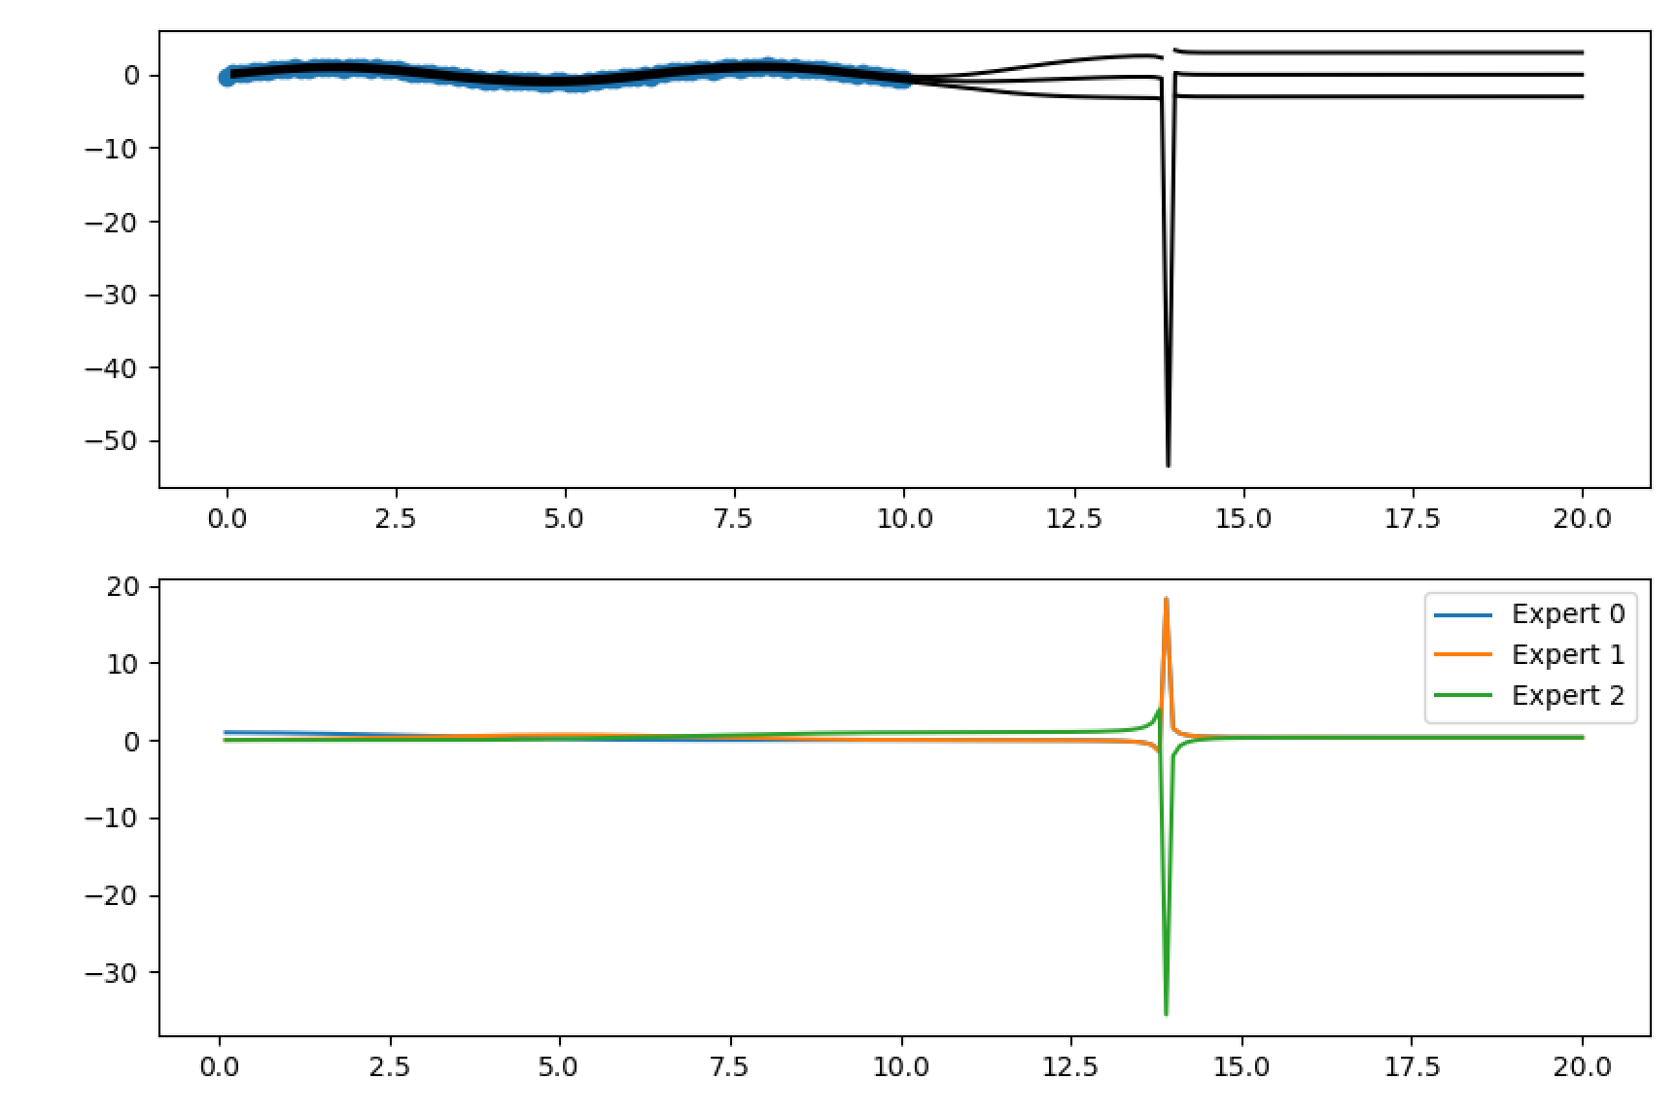
Generalised Product-of-Experts Gaussian Process
Initially, the Generalised PoE-GP implementation gave some very odd results when extrapolating beyond the training data.
The predictive power was becoming negative (which shouldn’t be possible!)
This was noted as an issue, but work on the Generalised PoE was paused when it became apparent that allowing each “expert” to have different parameters was the more significant issue.

Slide 21
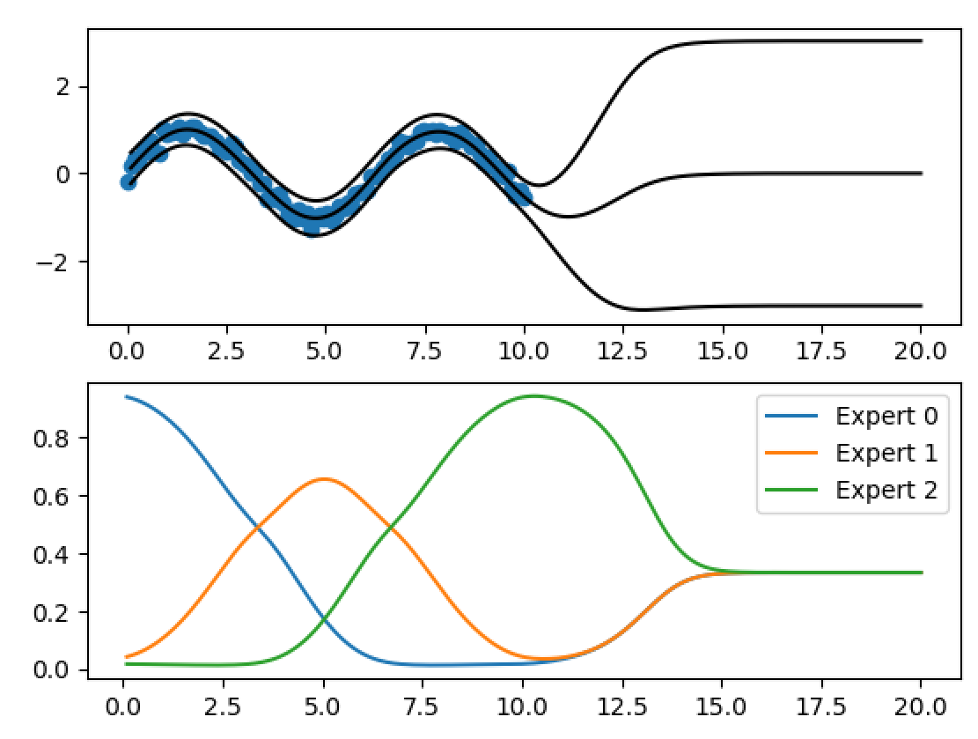
Generalised Product-of-Experts Gaussian Process
Returning to the Generalised PoE GP, the issue was resolved yesterday.
The issue arose because of a trick that we use when performing calculations that are close to machine-precision.
Perhaps the “predictive power” measure can give us an idea of which “expert” currently has the most influence over the predictions?
It’s still not clear to me how we communicate that the dominant expert may change over the next 72 hours (or even if we should?)
Predictive power

Slide 22
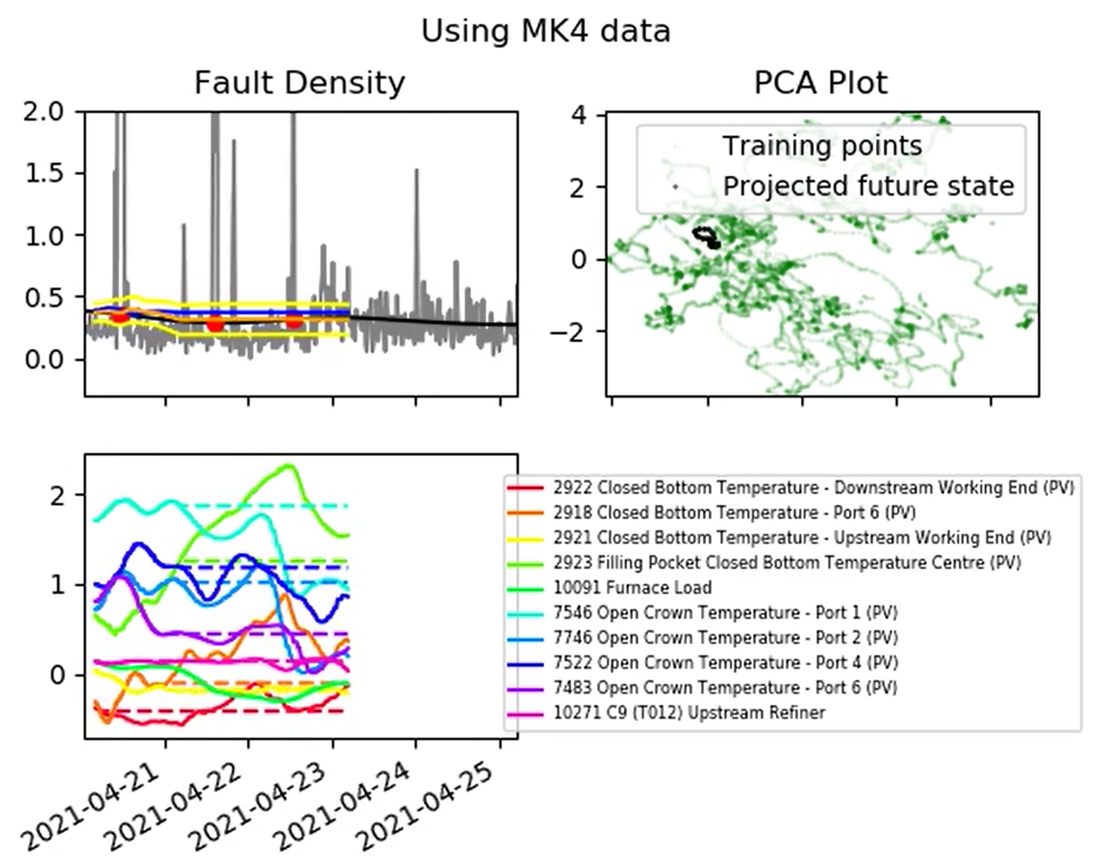
Generalised Product-of-Experts Gaussian Process
Generalised PoE GP tested on the MK4 data.
Managed to run this quickly (this morning!)
Didn’t have time to analyse all of the test data but initial results look very encouraging.

Slide 23
Conclusions
From previous meeting:
Implementation of PoE Gaussian Process model:
Using all of dataset 3 as training.
Using concatenation of datasets 1, 2, and 3 as training.
PCA only showing key inputs identified by the GP.
Including confidence bounds.
Updating input names
Apply to MK4 and ISRA

Slide 24
Conclusions
From previous meeting:
Implementation of PoE Gaussian Process model:
Using all of dataset 3 as training.
Using concatenation of datasets 1, 2, and 3 as training.
PCA only showing key inputs identified by the GP.
Including confidence bounds.
Updating input names
Apply to MK4 and ISRA

Slide 25
Conclusions
From previous meeting:
Implementation of PoE Gaussian Process model:
Using all of dataset 3 as training.
Using concatenation of datasets 1, 2, and 3 as training.
PCA only showing key inputs identified by the GP.
Including confidence bounds.
Updating input names
Apply to MK4 and ISRA
Independent MoE-GP approach, much better results on the MK4 testing data.
Generalised MoE-GP looking good too (also MK4).

Slide 26
Conclusions
From previous meeting:
Implementation of PoE Gaussian Process model:
Using all of dataset 3 as training.
Using concatenation of datasets 1, 2, and 3 as training.
PCA only showing key inputs identified by the GP.
Including confidence bounds.
Updating input names
Apply to MK4 and ISRA
Independent MoE-GP approach, much better results on the MK4 testing data.
Generalised MoE-GP looking good too (also MK4).
Possible next steps:
Application of Generalised PoE GP.
Addressing the change in important inputs.
Review?
ISRA data?

Slide 27
Thank you for your attention. ANY QUESTIONS?

